Slide 1
Iris Recognition Biometric System using Back-propagation Neural Network
Md Mobashshir jawaid (BE/10027/14)
Ankit kr Choudhary (Be/10417/14)
Tanmay Joshi (be/10446/14)
Under the guidance of:
Prof. S.K. CHATTERJEE

Slide 2
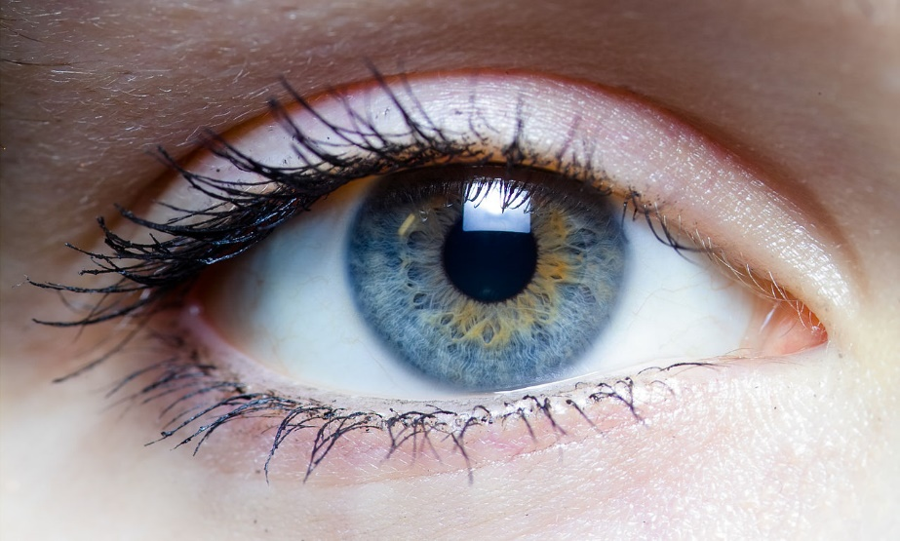
What is Iris Recognition?
Biometric system provides automatic identification of an individual based on a unique feature or characteristic possessed by the individual. Iris recognition is regarded as the most reliable and accurate biometric identification system available.
Irises of an individual's eyes have complex patterns which are unique, stable, and can be seen from some distance.
Advantage of iris biometrics is stability of iris as internal, protected, externally visible organ.

Slide 3
Objectives
Iris Segmentation and training NN -
From the image of an eye, segment and extract features of the iris and train the NN to be able to recognize individuals.
Recognition –
Recognize an individual based on the input image of an eye.

Slide 4
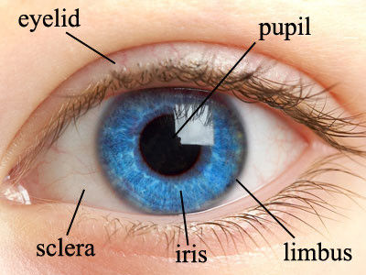
Iris
The iris is a thin, circular structure in the eye, responsible for controlling the diameter and size of the pupil and thus the amount of light reaching the retina.
Eye color is defined by that of the iris.
Each iris has a unique and highly complex pattern.

Slide 5
Iris Biometrics
The iris has a fine texture that—like fingerprints—is determined randomly during embryonic gestation.
Even genetically identical individuals such as twins have completely independent iris textures.
Iris is an organ whose structure remains stable throughout life. Iris doesn’t degenerate with aging. Thus it serves as a very good biometric for establishing identity of an individual.
It is an internal organ that is well protected against damage and wear by a highly transparent and sensitive membrane (the cornea). This distinguishes it from fingerprints, which can be difficult to recognize after years of certain types of manual labor.

Slide 6
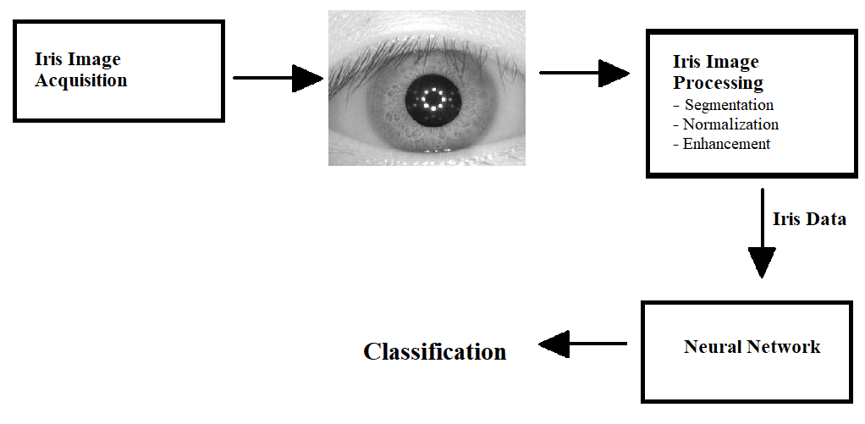
Iris Recognition: Overview

Slide 7
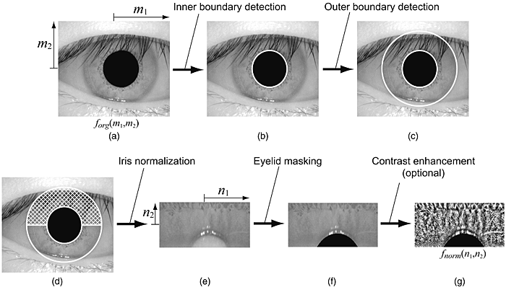
Image Pre-processing

Slide 8
Image Acquisition
Image Acquisition deals with capturing of a high quality image of the iris.
Most publicly deployed iris recognition systems use a 750 nm (near infrared wavelength band) wavelength light source to implement near-infrared imaging. This enables the system to block out light reflection from the cornea and acquire images of the detail-rich, intricate structures of the iris.
The majority of persons worldwide have "dark brown eyes", the dominant phenotype of the human population, revealing less visible texture in the VW band but appearing richly structured, like the cratered surface of the moon, in the NIR band.

Slide 9
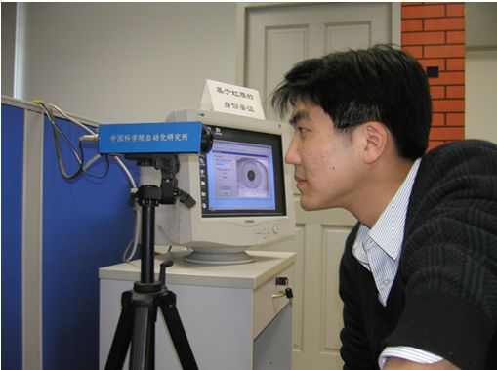
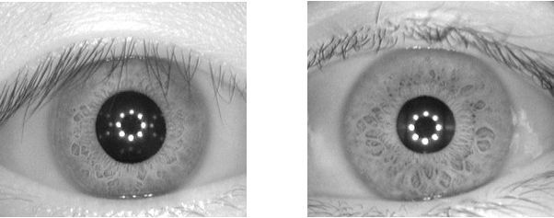
Database Used: CASIA-Iris
For the purposes of our iris recognition system, the CASIA Iris Image Database (CASIA-Iris), developed by the Institute of Automation, Chinese Academy of Sciences, has been used.
The self-developed iris camera used for collection of CASIA-Iris-Interval
Example of iris images in CASIA-Iris database

Slide 10
Iris Segmentation
First part of the segmentation process performs the Inner circle boundary detection to localize the pupil in the image.
This is done using a function to find Contours in the image with grayscale values in a given dark range expected in pupil in a circular area.
This function returns a circle from which centre of the pupil, and consequently the iris, as well as the radius of the pupil is obtained
The pupil is also masked to remove the reflection of illuminating light source in the pupil region which is not in the Region of interest.

Slide 11
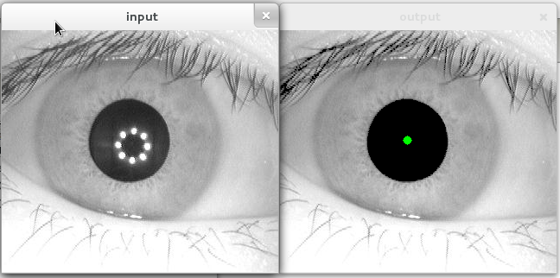
Iris Segmentation
Detection of the pupil centre in the eye image

Slide 12
Iris Segmentation
Second part of the localization and segmentation process is used to find the outer boundary of the iris.
A function is used which performs Circular Hough Transform on canny edge detection transformed image to find circular outer boundary of the iris.
The circular Hough Transform is a feature extraction technique for detecting circles. It is a specialization of Hough Transform. The purpose of the technique is to find circles in imperfect image inputs. The circle candidates are produced by “voting” in the Hough parameter space and then select the local maxima in a so-called accumulator matrix.

Slide 13
Iris Segmentation
A circle is represented mathematically as
Here the parameters for Hough Circle Transform are (x_{centre,} y_{centre}) and r.
From equation, we can see we have 3 parameters , so we need a 3D accumulator for hough transform. So OpenCV (which is a computer vision library we have used in Python for Image Processing) uses the gradient information of edges to find circles in an image.
Then a mask was used to remove the part of image outside of the iris circle and get a circular ring image containing only the iris.

Slide 14
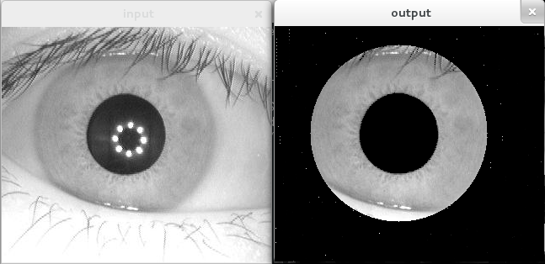
Iris Segmentation

Slide 15
Why Iris Segmentation?
Iris segmentation and subsequent masking of the image to remove areas outside the Iris ring was done to ensure that the matching process is not effected by variations in regions of the image that are not the iris.
Another reason to separate this ring is so that it can be normalized into a rectangular band by the normalization step to account for variation due to pupil contraction and dilation.

Slide 16
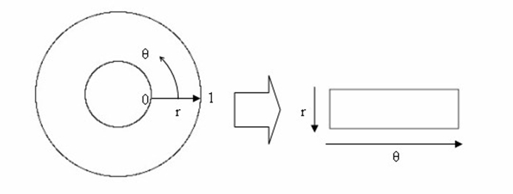
Normalization
The segmented iris region is normalized using Daugman’s Rubber Sheet Model in the normalization stage. The circular iris region is transformed to a rectangular block so that it has fixed dimensions.

Slide 17
Normalization
The remapping of the iris region from (x, y) Cartesian coordinates to the normalized non-concentric polar representation is modelled as –
I (x(r, θ), y(r, θ)) → I(r, θ)
With x (r, θ) = (1-r) x_{p} (θ) + r x_{i}(θ)
and y (r, θ) = (1-r) y_{p} (θ) + r y_{i}(θ)
where x_{p} (θ) = x_{p0} (θ) + r_{p} cos (θ) , y_{p} (θ) = y_{p0} (θ) + y_{p} cos (θ)
x_{i} (θ) = x_{i0} (θ) + r_{i} cos (θ) , y_{i} (θ) = y_{i0} (θ) + y_{i} cos (θ)

Slide 18
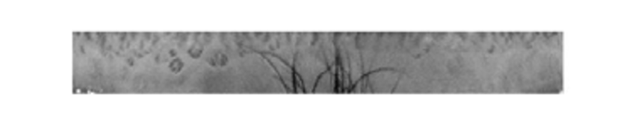
Normalization
Normalized Iris Image

Slide 19
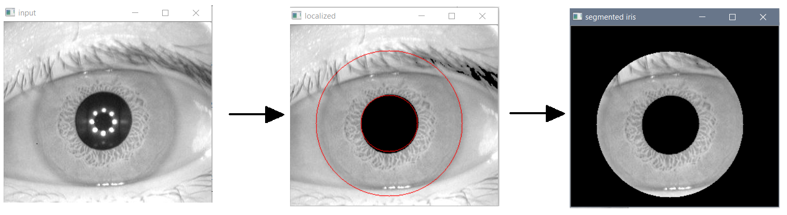
Image Processing Overview
1. Localization and Segmentation

Slide 20
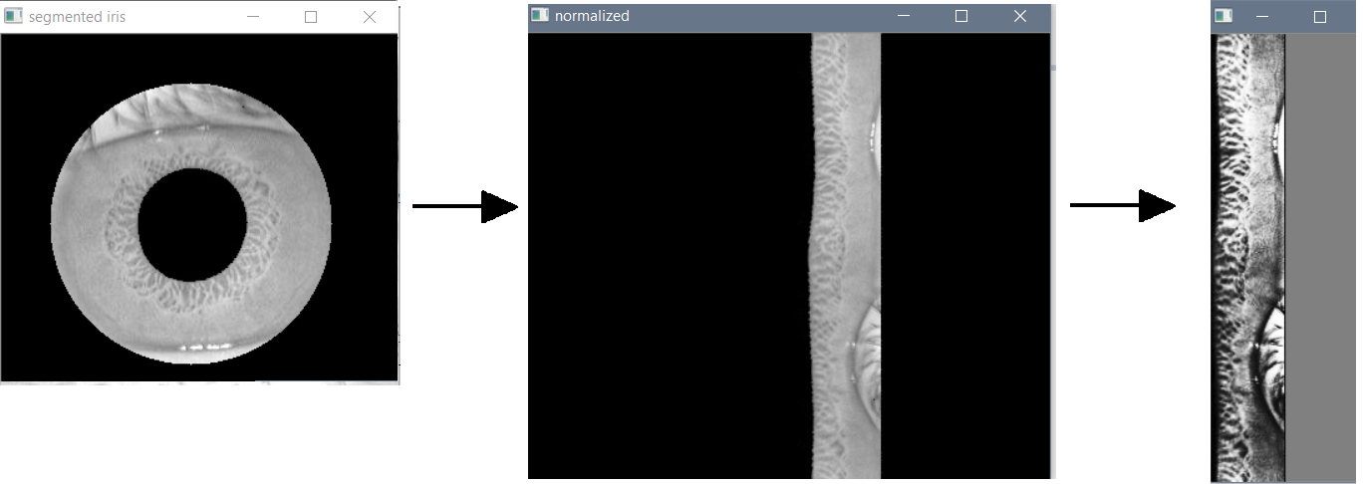
Image Processing Overview
2. Normalization and Enhancement

Slide 21
Input to Neural Network
The detected irises after normalization and enhancement by matrices. These matrices are the input signal for the neural network. The outputs of the neural network are classes of iris patterns.
The normalized iris image was 60x180 pixels in resolution. The greyscale values were used as input vector to the NN. Thus the number of input neurons is 10,800 (60*180).
20 person’s irises are selected from iris database for classification, with each person having 10 eye images. Thus the output layer has 20 neurons. Each class characterizes the certain person’s iris.

Slide 22
Neural Network
Artificial neural networks (ANNs), a form of connectionism, are computing systems inspired by the biological neural networks that constitute animal brains.
Such systems learn (progressively improve performance) to do tasks by considering examples, generally without task-specific programming. For example, in image recognition, they might learn to identify images that contain cats by analyzing example images that have been manually labelled as "cat" or "no cat" and using the analytic results to identify cats in other images.

Slide 23
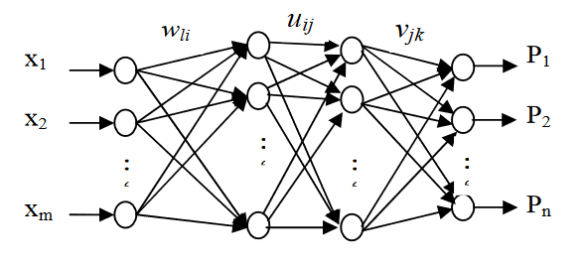
Machine Learning Classifier (BP Neural Network)
Schematic diagram of the Back-propagation Neural Network

Slide 24
Neural Network Architecture
For our NN the activation function used is the Sigmoid function and the number of neurons in the hidden layers are according to the formula proposed by Huang et al. (2003) which is
h1 = sqrt[(n+2)m]+2sqrt[m/(n+2)] and h2 = n*sqrt[m/(n+2)]
where h1 and h2 are number of neurons in first and second hidden layers, m is number of neurons in input layer, n is number of neurons in output layer.
During training, the value of the cost function used is the mean squared error cost function. Gradient descent Back Propagation algorithm was used for parameter learning in the training of the neural network (BPNN).

Slide 25
Experimental Results
The normalized iris image was 60x180 pixels in resolution. The greyscale values were used as input vector to the NN. Thus the number of input neurons was 10,800 (60*180).
20 person’s irises are selected from iris database for classification, with each person having 10 eye images. Thus the output layer has 20 neurons.
Two hidden layers are used in neural network. The number of neurons in the first and second hidden layers are 530 and 440, correspondingly.

Slide 26
Experimental Results
From each set of iris images, 7 images were used for training and 3 for testing. Thus a total of 140 images were used for training of the NN and 60 images used for testing.
After training the remaining images are used for testing. The recognition rate of NN system was 96.67%. The obtained recognition result is compared with the recognition results of other methods that utilize the same iris database.

Slide 27
Experimental Results
Methodology | Accuracy
Daugman | 99.90%
Boles | 92.64%
Li Ma | 94.90%
Avila | 97.89%
Neural Network | 96.67%
Recognition performance compared with existing methods

Slide 28
Conclusion
This project has presented an iris recognition system, which was tested using a database of greyscale eye images in order to verify the claimed performance of iris recognition technology. 20 person’s irises were selected from iris database for classification with each person having 10 eye images.
The recognition rate of NN system was 96.67%. Through the gathered accuracy percentage from the set of trials, it can be concluded that the implemented iris recognition system is reliable.

Slide 29
Challenges faced
Segmentation is the most critical stage of iris recognition, since areas that are wrongly identified as iris regions will corrupt biometric templates resulting in very poor recognition.
The threshold values needed for detecting iris region boundaries had to be chosen through trial and can change depending on database and image acquisition method used. Although if the same acquisition method is used throughout the system then this is only needed to be set once for the whole database.

Slide 30
Challenges faced
Noise in images caused due to eyelashes caused slight decrease in accuracy of the system. Although our algorithm minimized the error produced due to such noise, even more advanced methods to handle noise due to eyelashes can be used to further improve accuracy of the system.

Slide 31
Future Work
An authentication system to unlock a user’s phone or computer can be implemented using the recognition system proposed in this project.
Another extension to the system would be to interface it to an iris acquisition camera. Now, rather than having a fixed set of iris images from a database, a frame grabber can be used to capture a number of images, possibily improving the recognition rate.
In order to improve the automatic segmentation algorithm, a more elaborate eyelid and eyelash detection system could be implemented.

Slide 32
References
J. Daugman. How iris recognition works. IEEE Transactions on Circuits and Systems for Video Technology, Vol. 14, No. 1.
Libor Masek. Recognition of Human Iris Patterns for Biometric Identification. School of Computer Science and Soft Engineering, The University of Western Australia.
Rahib H.Abiyev, Koray Altunkaya. Personal Iris Recognition Using Neural Network. International Journal of Security and its Applications Vol. 2, No. 2, April, 2014.
Guang-Bin Huang. Learning Capability and Storage Capacity of Two-Hidden-Layer Feedforward Networks. IEEE Transactions on Neural Networks, vol. 14, no. 2.
S.Mahajan et al. An LBP based Iris Recognition System using Feed Forward Backpropagation Neural Network. International Journal on Recent and Innovation Trends in Computing and Communication Vol. 5, No. 5, 2016.

Slide 33
References
Bhawna Chouhan et al. Iris Recognition System using canny edge detection for Biometric Identification. International Journal of Engineering Science and Technology (IJEST), 2016.
J. Daugman. New methods in iris recognition. Systems, Man, and Cybernetics, Part B: Cybernetics, IEEE Transactions on, 37(5):1167-1175, 2007.
W. Boles and B. Boashash, “A Human Identification Technique Using Images of the Iris and Wavelet Transform,” IEEE Trans. Signal Processing, vol. 46, no. 4, pp.1185-1188.
L.Ma, Y.H.Wang, T.N.Tan, “Iris recognition based on multichannel Gabor filtering”. Proceedings of the Fifth Asian Conference on Computer Vision, Australia, pp.279-283.

